Slide 1
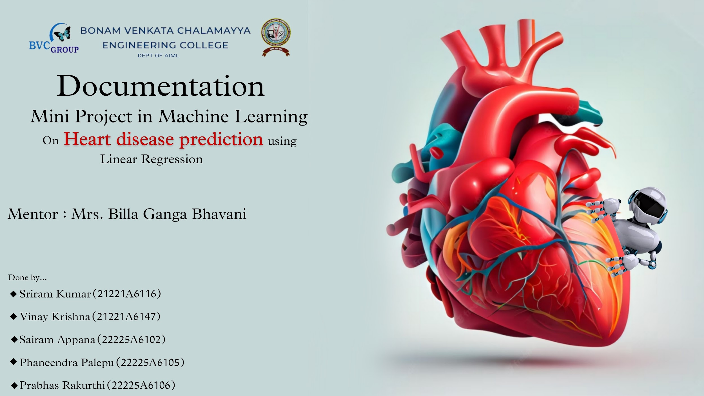

Slide 2

Content:
The goal of this mini project is to predict percent population with heart disease.
The final output should take two inputs from the user and predict the output.
Training the model.
> Using Jupyter Notebook.
Deploying trained model into a local web app.
> Using Flask and python.
And finally deploying the trained model as a web app (so that anyone can use it globally).
> Using github.com and redner.com
All the required data will be available at : https://github.com/prabhasrakurthi/MachineLearningModelAiml.github.io

Slide 3

Training the model using jupyter notebook:
Import libraries (numpy,pandas and seaborn).
Load the data set(“heart_data.csv”) which contains data of percent of population biking and percent of population smoking.
If the smoking percent is high then there must be high rate of heart disease.
Plot few points in seaborn to understand the data.
Split the data into training data and testing data.
Import linear_model from sklearn.
Create a linear regression object.
Call ‘fit’ method to train the model using independent variables.
Check if the mean sq. error is negligible or not.
Import pickle and name the model with ‘.pkl’ extension.(“model.pkl”)
Now the model is ready to predict and it will be saved in your device .

Slide 4
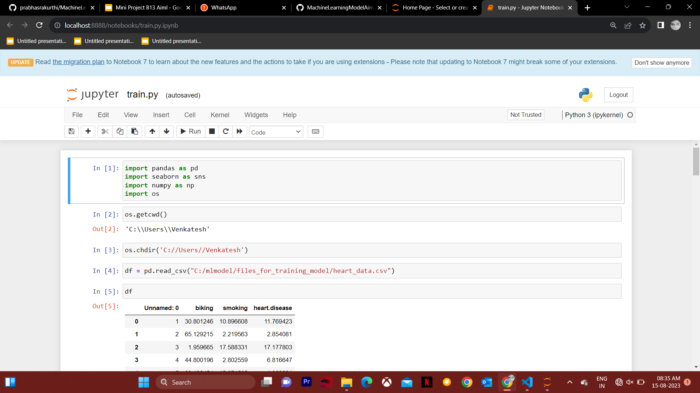
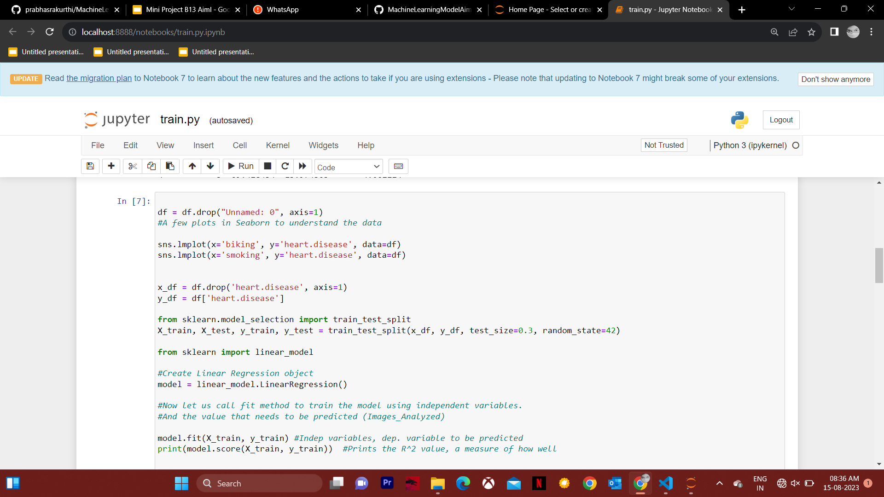

Slide 5
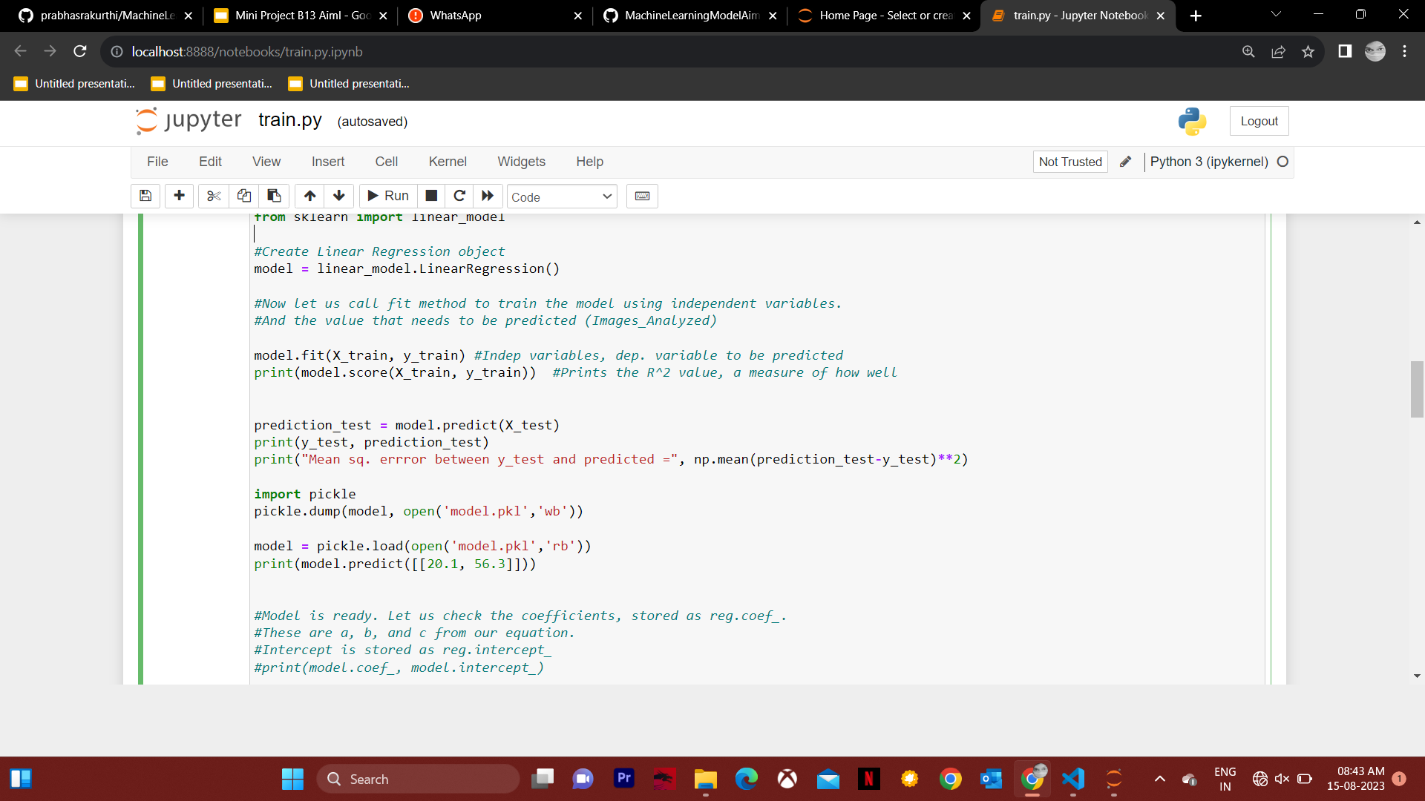
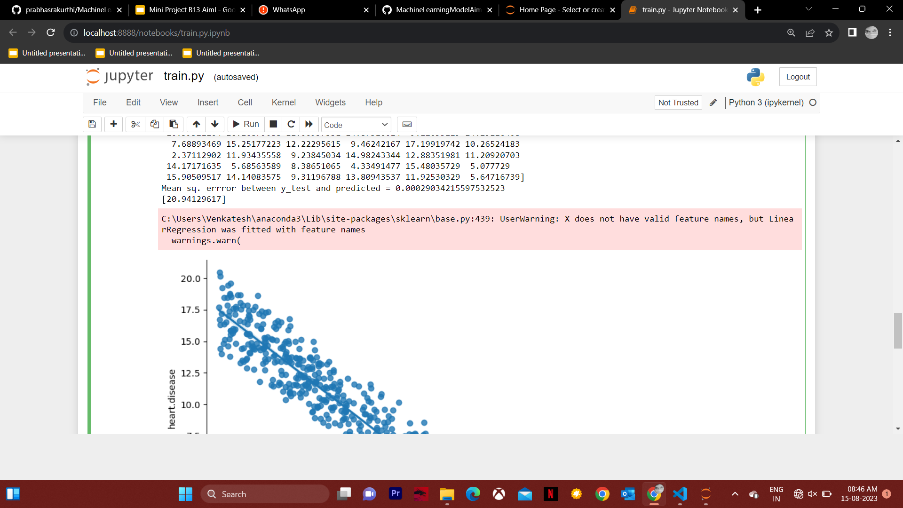
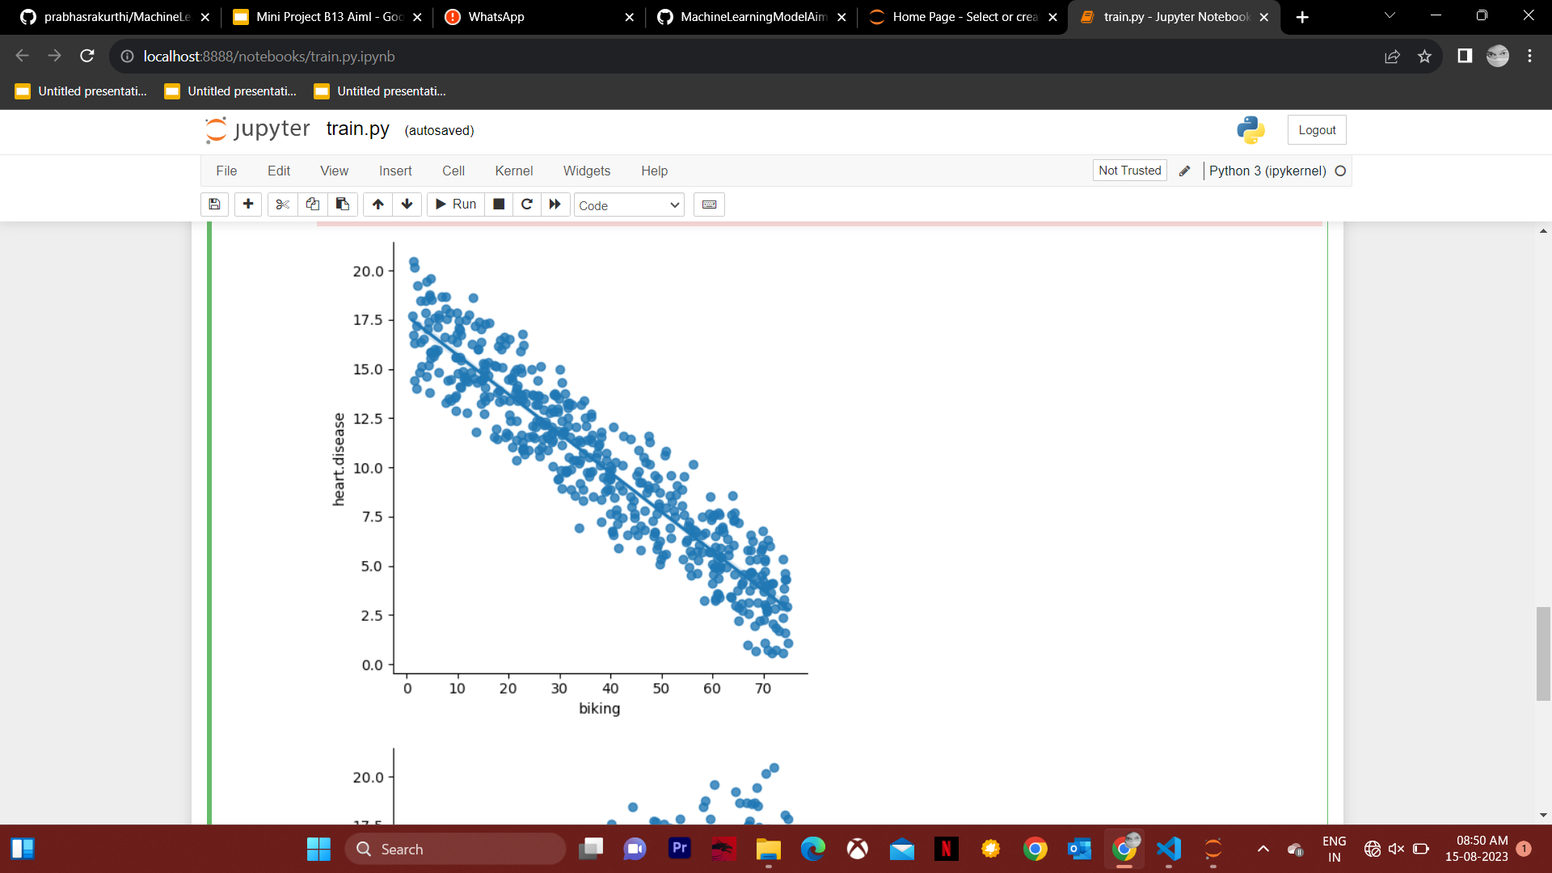
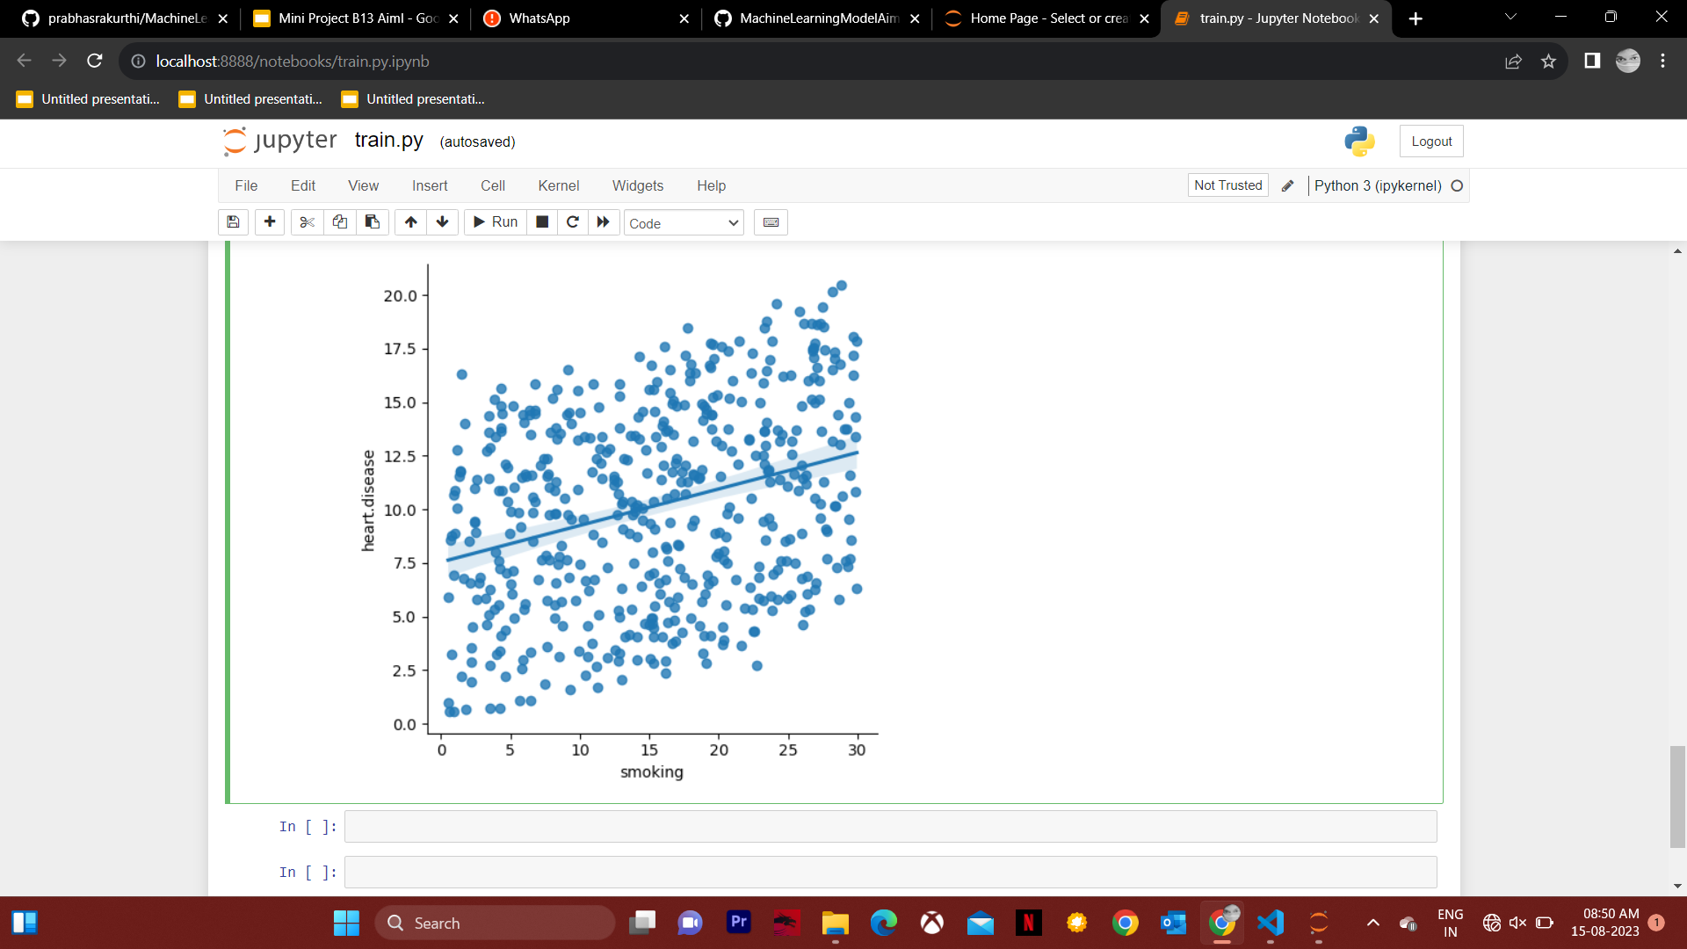

Slide 6

Deploying model into a local web app:
Flask : It is a web framework, python module that lets you develop web applications easily. It enables the Web Server Gateway Interface(WSGI)(communication b/w web app and server).
Before entering into the deployment pip install the following:
>Flask
>pandas
>numpy
>requests
>pickle4
>gunicorn
>scikit-learn
Open visual studio code and name the file as ‘app.py’ and write the required python code.

Slide 7
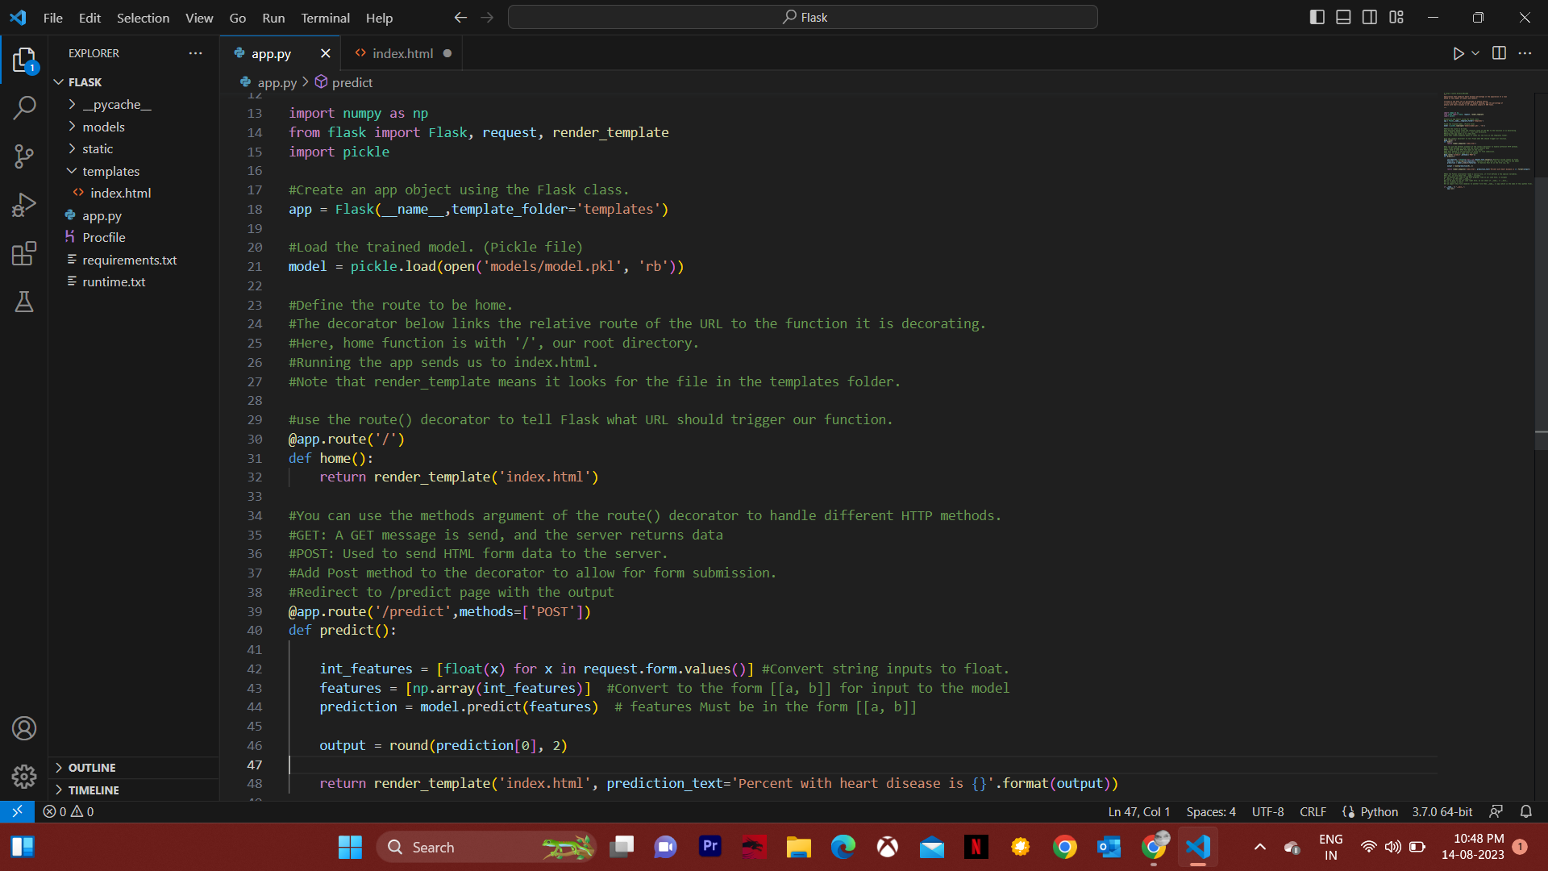
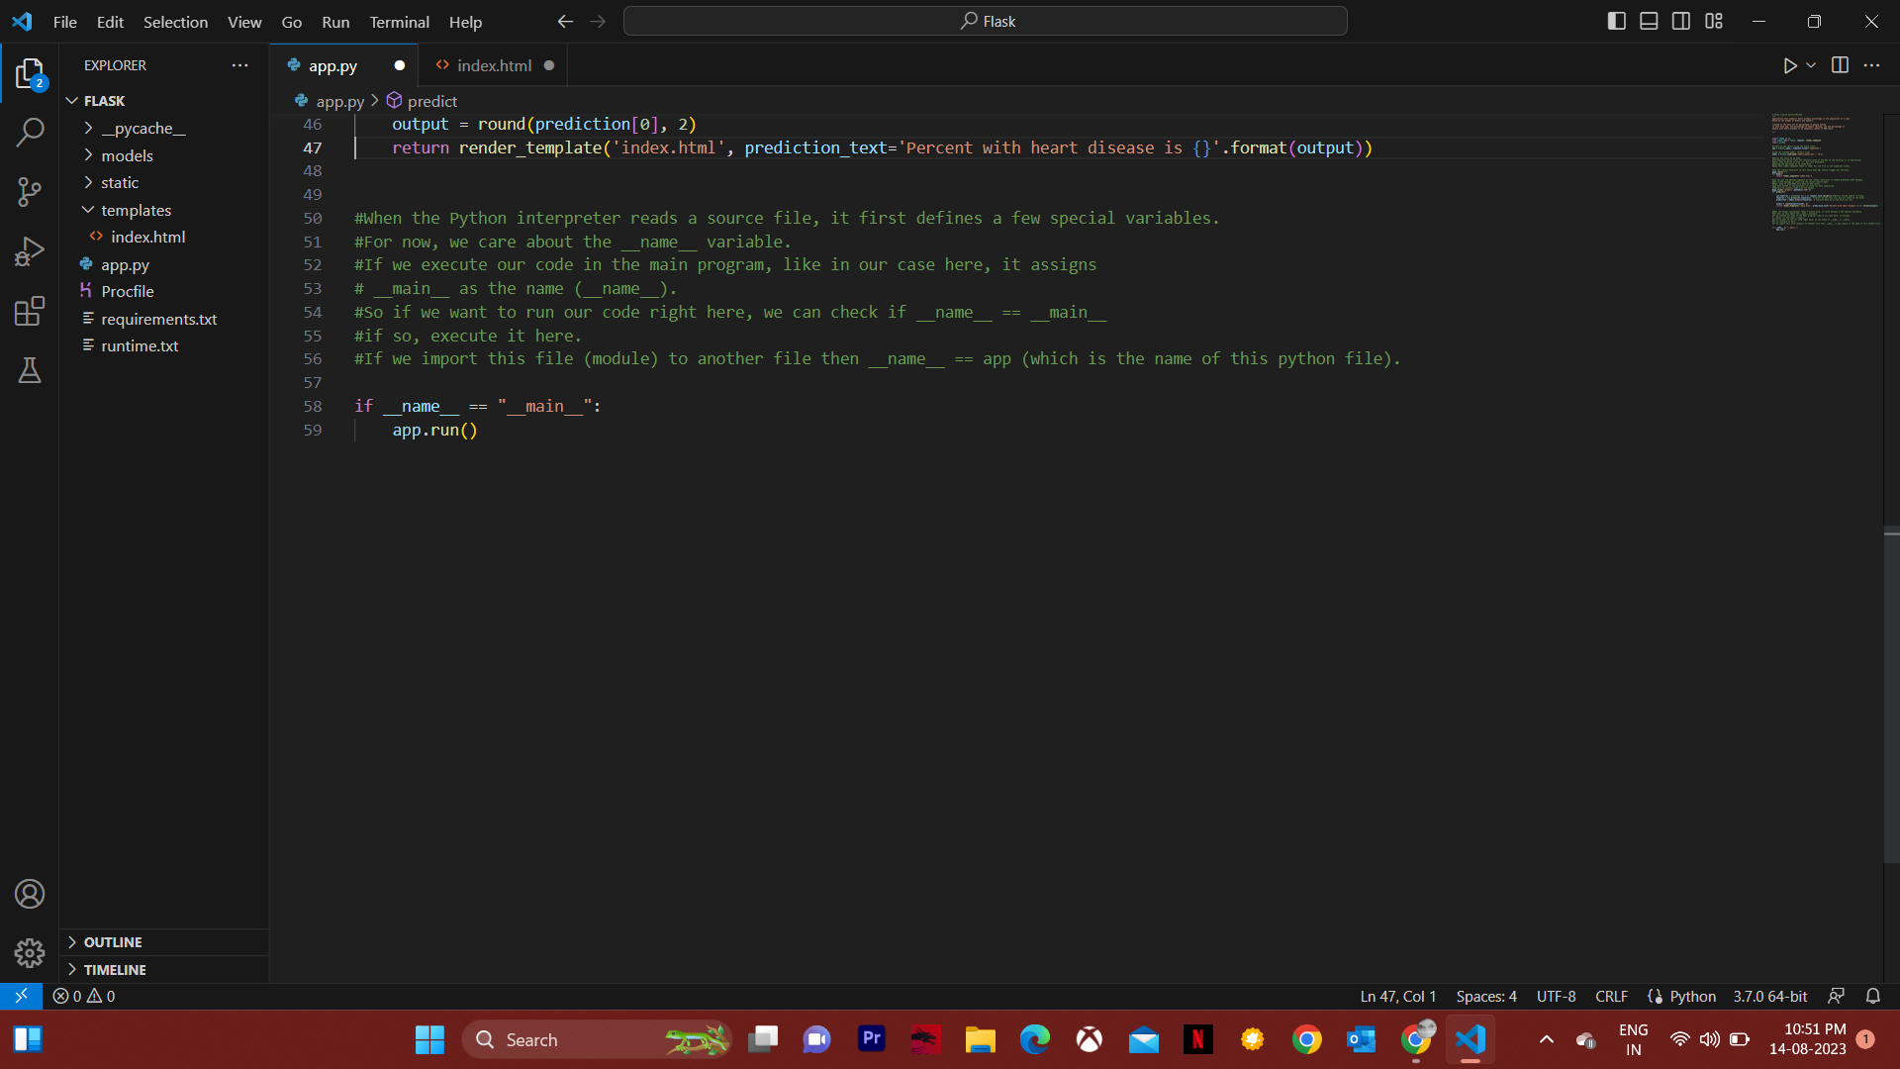

Slide 8
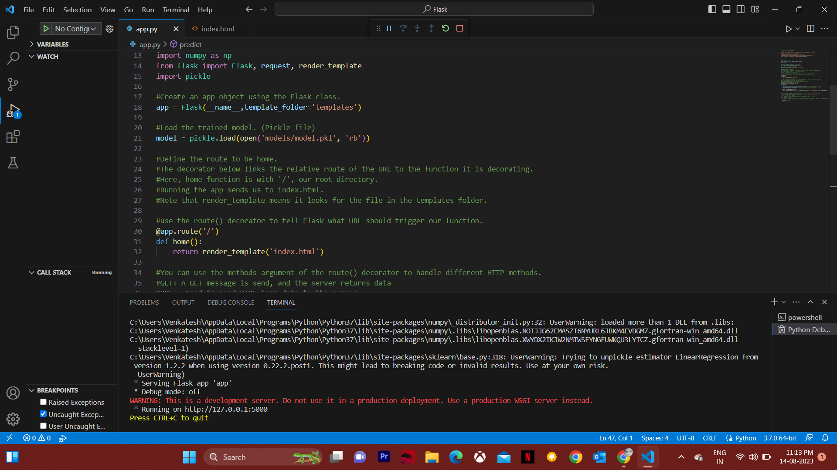
We need a html file to enter the input and get the output.
So, create a html file in a folder named ‘templates’.
Here, when you run the python code it searches for a template, it renders the template folder and finds html file.
And gives you a URL containing your default port.
Now copy the link and paste it in a browser.
You can see the output now.

Slide 9

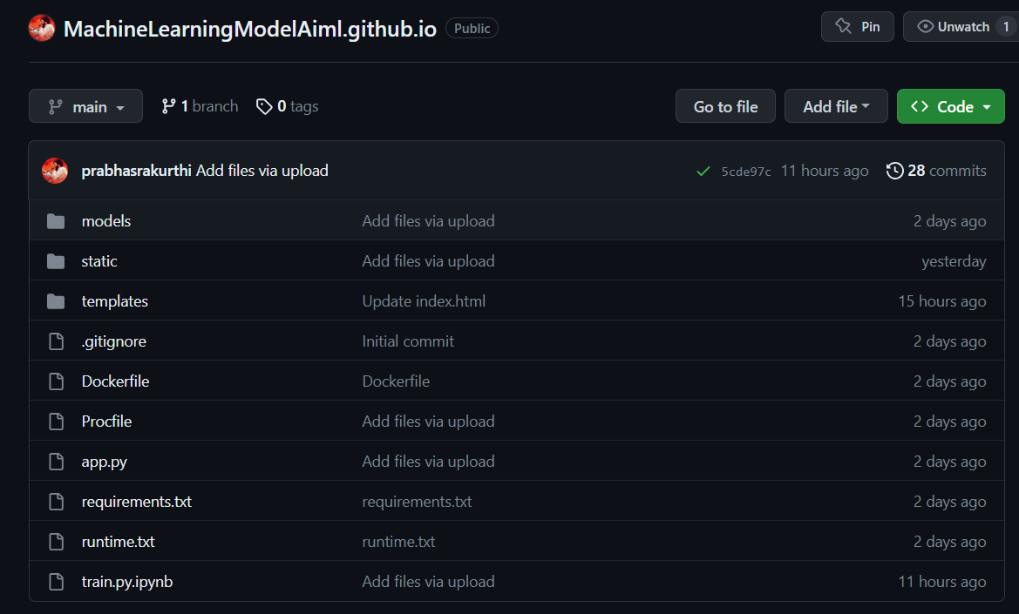
Deploying model as web app(cloud application hosting):
Create a github account if you don’t have one.
Create a repository and upload all the required files to it.

Slide 10
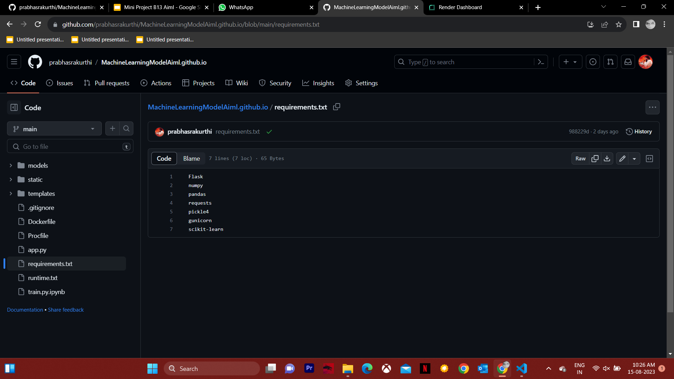
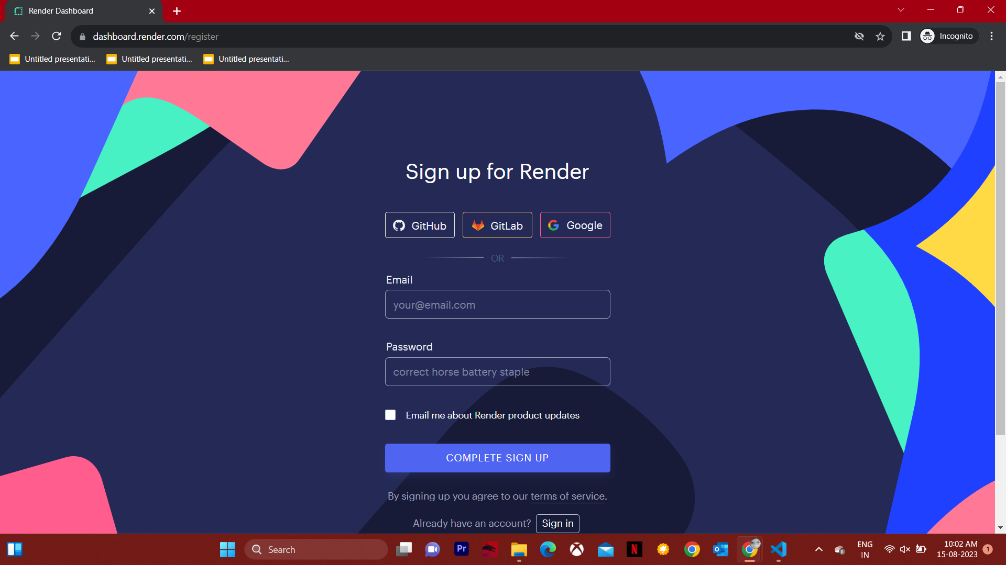
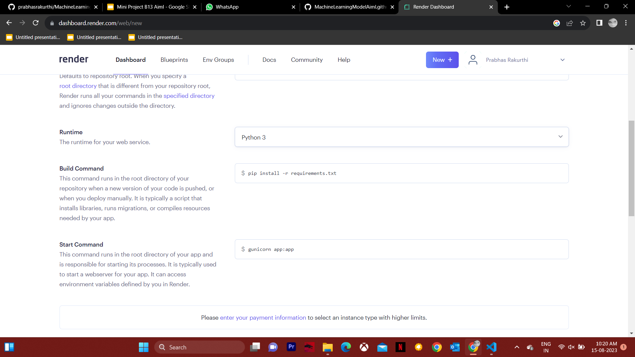
In addition to those files add a text file named ‘requirements’
which should contain:
Now we have to connect github to the render.
.> Render: It is a Cloud hosting Application.
Open https://render.com/ and sign using github account
Allow the permissions to access your github repository.
Now click on new web service and select the github repository.
Give a unique name for your web service.
Make sure to select the runtime as python3.

Slide 11
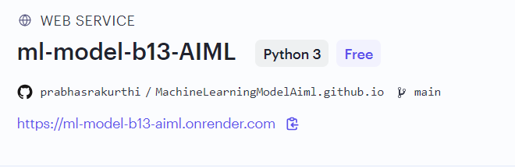
Build command and start command will be filled automatically. If not enter these commands:
>pip install -r requirements.txt
>gunicorn app:app
Now click on ‘Create web service’ button which will be located at bottom left of the page.
Now the web service will be deployed automatically and provides a URL for the web app which can be accessed globally.
Link : https://ml-model-b13-aiml.onrender.com
Thank You :)

